Slide 1

Capstone Project
Financial Data
Gourav Kinker

Slide 2

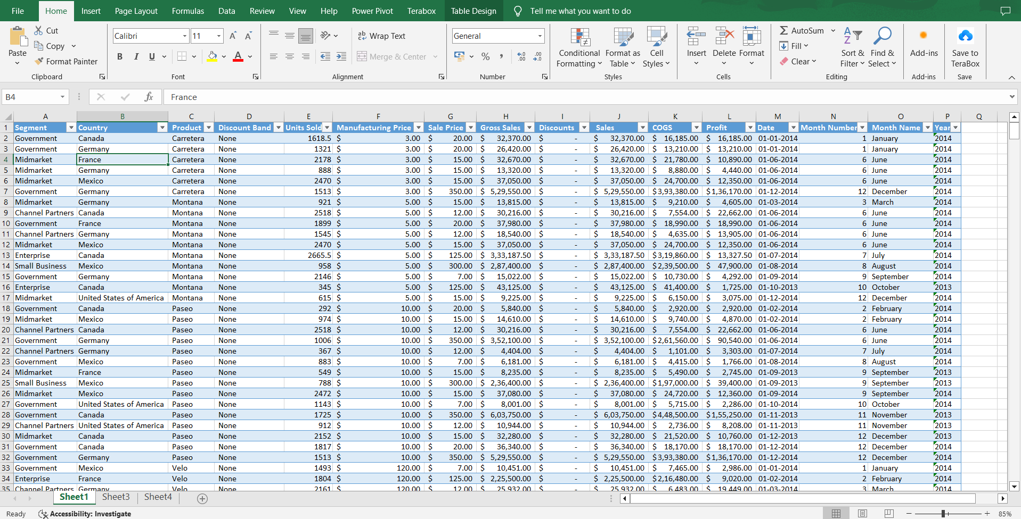
Dataset Overview
Snapshot of our Financial Data. This table provides key insights into sales, profits, and segment details, forming the basis of our analysis. The sample data contains 11,216 records with 16 columns of information.

Slide 3
Country-wise Profit
Our pivot table shows profits by country. France leads with $3,781,020.78, while Mexico has the lowest at $2,907,523.11. This analysis highlights diverse financial performances across our target countries.
Segment vs. Profit Pivot
Pivoting by segments, Government leads with a profit of $11,388,173.17, while Enterprise trails with -$614,545.63, indicating the lowest profit in this category.

Slide 4
Monthly Profit
Using a pivot table to analyze monthly profits in 2014, October emerges as the standout month, recording the highest profit among all months.
Product vs. Unit Sold
Our Cluster Column Chart reveals that among the products, "Paseo" stands out with the highest number of units sold, showcasing its strong performance.

Slide 5
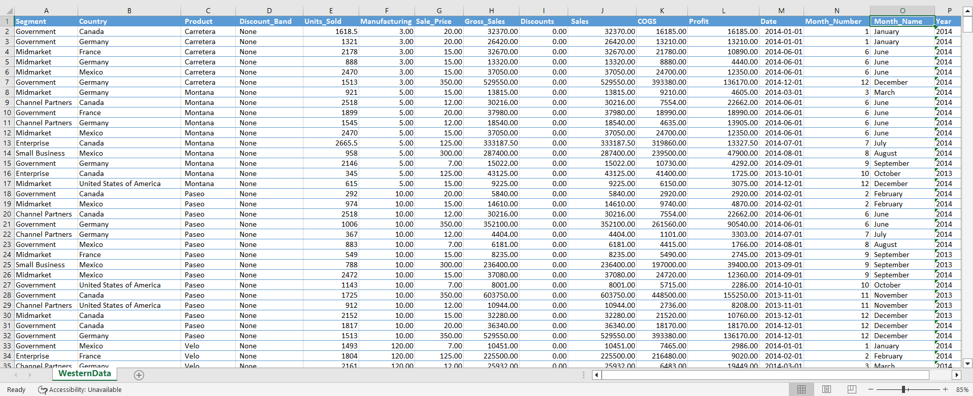
Data Transformation
To upload data from Excel to SQL after performing transformations like changing column names and change format currency"$"to number:

Slide 6

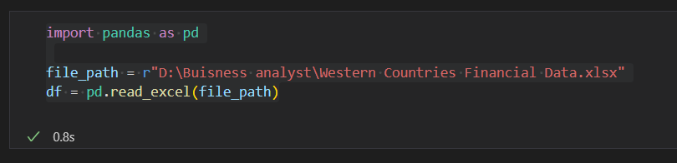
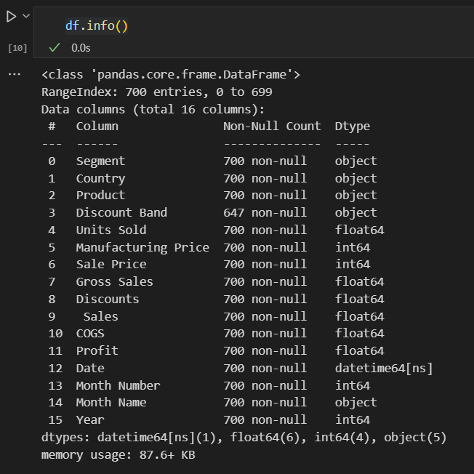
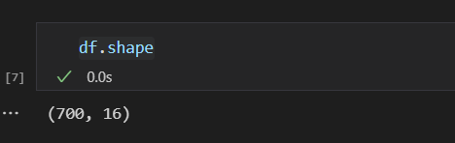
statistical Analysis With Pandas In Python
1.Imports the pandas library as pd and Reads the Excel file located at "D:\Buisness analyst\Western Countries Financial Data.xlsx" into a pandas DataFrame df.
2. Prints information about the DataFrame using df.shape and df.info() which provides details such as the column names, data types, and memory usage.

Slide 7
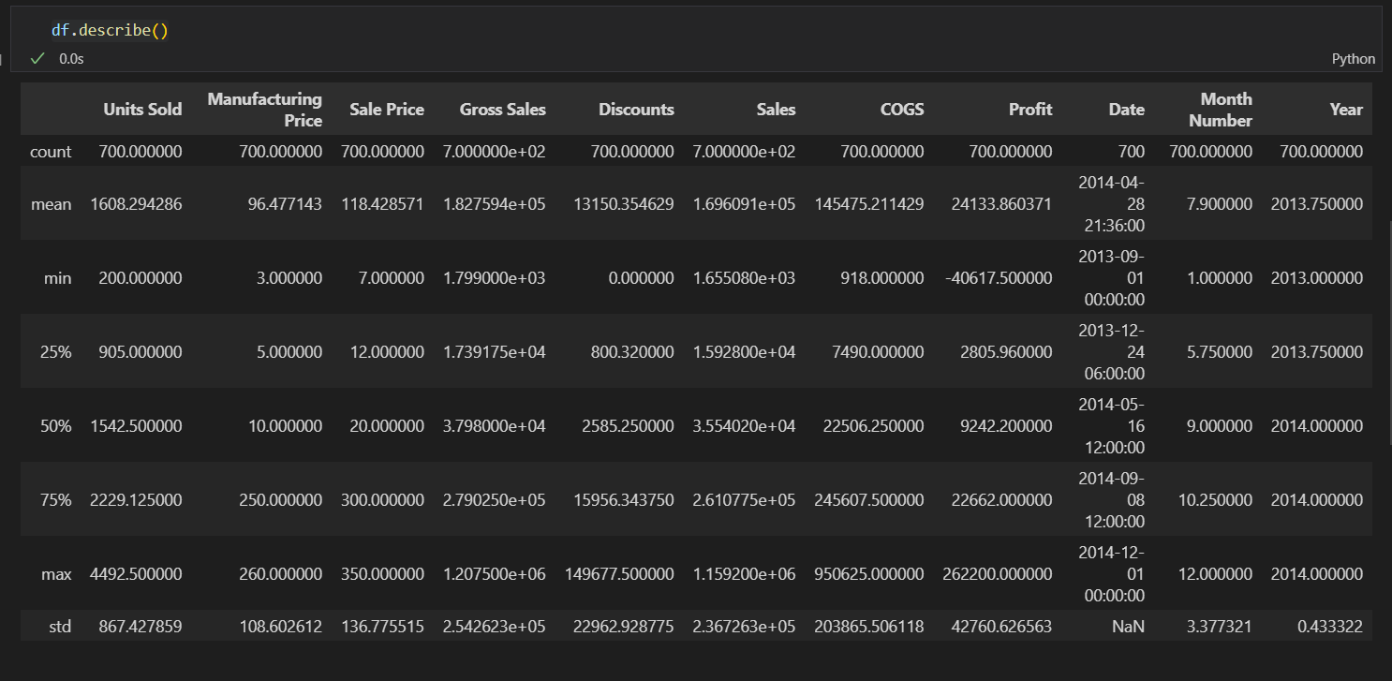
3.Generates descriptive statistics for numerical columns in the Data Frame using df.describe(), including count, mean, standard deviation, minimum, quartiles, and maximum values
Gourav Kinker

Slide 8
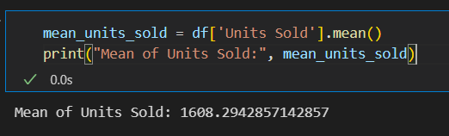
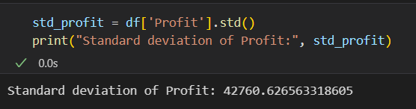
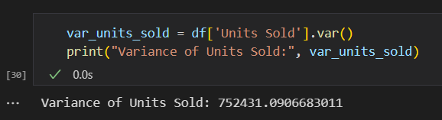
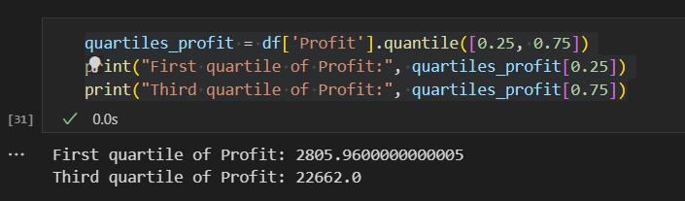
4. Calculates the mean of the Units Sold.
5. Calculates the standard deviation of the Profit.
6.Calculates the variance of the Units Sold.
7.Calculates the first and third quartiles of the Profit.

Slide 9
Python Statistical Analysis: Data Insights from Financial Data
The mean number of units sold across the dataset is 1608.29 units .
The standard deviation of profit within the dataset is $42,760.63. This metric indicates the degree of variability or dispersion in profit values around the mean, offering insights into the dataset's volatility.
The variance of units sold is 752,431.09. This represents the average of the squared differences from the mean, providing a measure of the spread or variability in the number of units sold.
The first quartile (25th percentile) of profit is $2805.96 indicating that 25% of the profit values fall below this threshold. This quartile helps understand the distribution of profit values, particularly focusing on the lower end of the spectrum.
The third quartile (75th percentile) of profit is $22,662, suggesting that 75% of the profit values fall below this threshold. This quartile provides insight into the distribution of profit values towards the higher end of the spectrum.

Slide 10

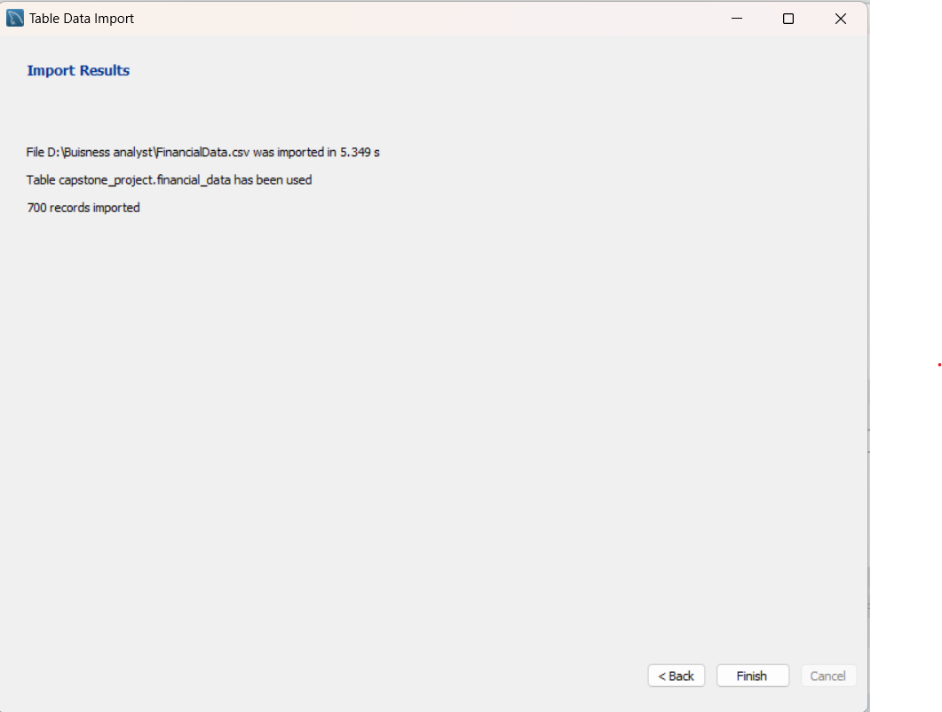
Financial Data From Excel To SQL
Explore the seamless transition of financial datasets from Excel to SQL databases, optimizing data management and analytical capabilities for enhanced insights and decision-making.

Slide 11

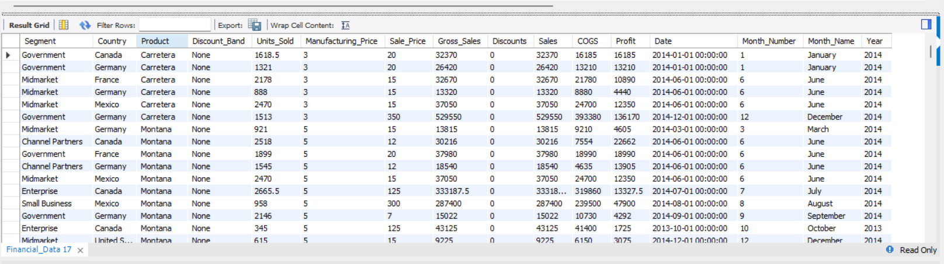
Extracting Insights: Analyzing Financial Data Using SQL Queries
1) Display all records from the Financial_Data
Provides a comprehensive view of the entire financial dataset, offering insights into individual transactions and their attributes.

Slide 12

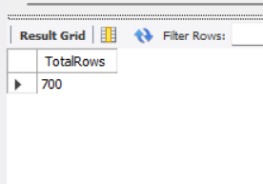
2) Count the total number of record
Quantifies the size of the dataset, indicating the volume of financial transactions captured.

Slide 13

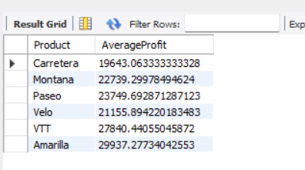
3) Calculate the total units sold and total profit
Summarizes the aggregate performance metrics, showcasing the cumulative units sold and total profit generated across all transactions.

Slide 14
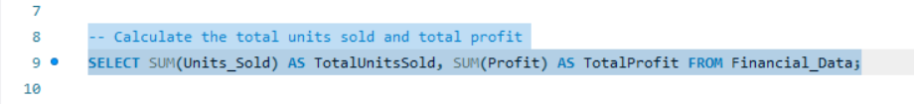
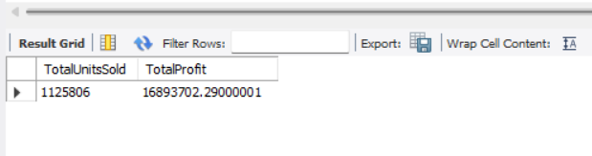
4) Calculate the total units sold per country
Highlights the distribution of sales activity across different countries, revealing regional sales trends and disparities.

Slide 15
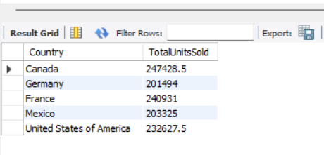
5) Find the maximum sale price among all products
Identifies the highest sale price attained within the dataset, offering insights into pricing dynamics and potential outliers.+

Slide 16

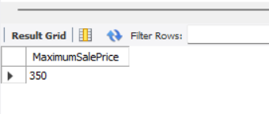
6) Calculate the average profit per product category
Evaluates the profitability of each product category on average, aiding in strategic decision-making and resource allocation.

Slide 17

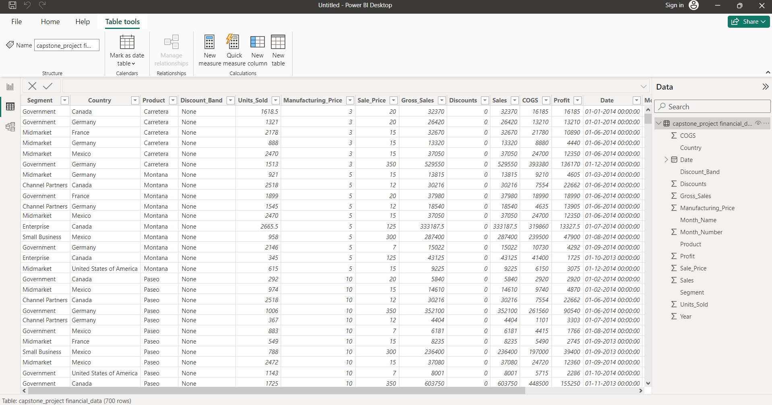
Financial Data From SQL To Power BI
Delivers an extensive analysis of the financial dataset, presenting detailed insights into transactional data and associated attributes.

Slide 18
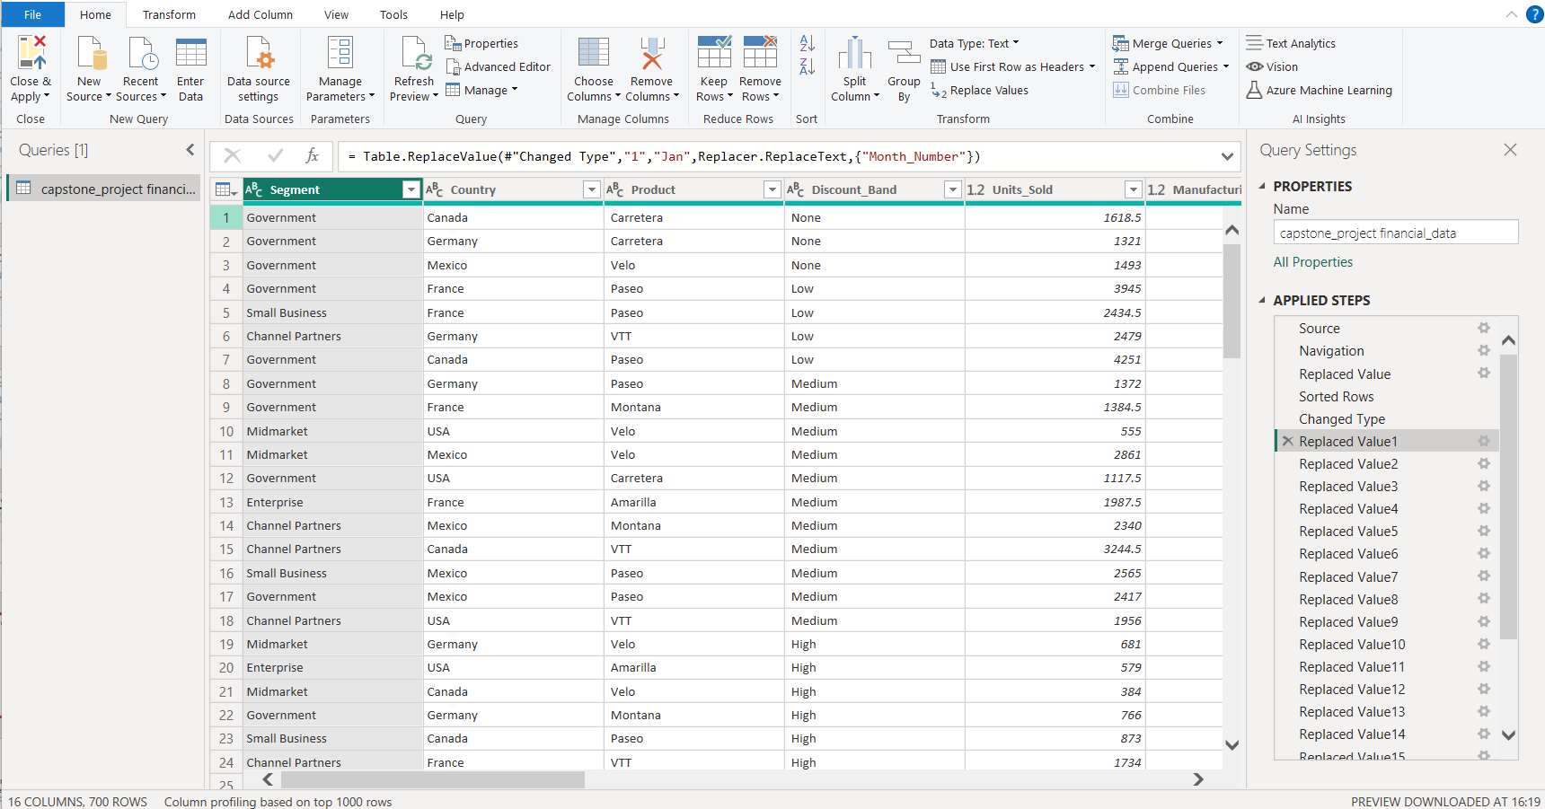
Data Refinement and Transformation: Power Query in Power BI
Implemented measures to analyze gross sales and adjusted data types for specific columns, ensuring enhanced data analysis capabilities while maintaining consistency and clarity across the dataset.

Slide 19
Exploring Financial Insights with Power BI
Product wise Sales
Segment wise Profit
Country wise Sales
Amarilla = 1,77,47,116.07
Carretera = 1,38,15,307.89
Montana = 1,53,90,801.88
Paseo = 3,30,11,143.96
Velo = 1,82,50,059.47
VTT = 2,05,11,921.02
Government = 1,13,88,173.18
Small Business = 41,43,168.5
Enterprise = -6,14,545.62
Midmarket = 6,60,103.09
Channel Partners = 13,16,803.14
Canada = 2,48,87,654.89
France = 2,43,54,172.29
Germany = 2,35,05,340.82
Mexico = 2,09,49,352.11
USA = 2,50,29,830.18
Yearly sales
Yearly profit
Profit and sales by Qtr
2013 = 2,64,15,255.51
2014 = 9,23,11,094.77
2013 = 38,78,464.51
2014 = 1,30,15,237.78
Q1 = Profit (2.63M) Sales (19.49M)
Q2 = Profit (3.23M) Sales (22.69M)
Q3 = Profit (3.53M) Sales (24.85M)
Q4 = Profit (7.53M) Sales (51.69M)

Slide 20
Top2 countries
Bottom3 products
Sales
USA = 2,50,29,830.18
Canada = 2,48,87,654.89
Sales
Carretera = 1,38,15,307.89
Montana = 53,90,801.87
Amarilla = 1,77,47,116.07
Profit
France = 37,81,020.79 Germany = 36,80,388.82
Profit
Carretera = 18,26,804.88
Montana = 21,14,754.88
Velo = 23,05,992.46
Product wise discount
No. of units sold year over year
Amarilla = 12,90,163.45
Carretera = 11,22,212.61
Montana = 11,59,032.62
Paseo = 26,00,518.06
Velo = 15,76,709.04
VTT = 14,56,612.47
2013 = 2,64,674
2014 = 8,61,132

Slide 21
Segment wise Product Sales
1) Government
Amarilla = 99,42,899.10
Carretera = 60,80,944.07
Montana = 55,48,936.02
Paseo = 1,48,82,230.70
Velo = 7813,422.04
VTT = 82,35,828.70
2) Small Business
Amarilla = 45,94,281
Carretera = 39,10,512
Montana = 66,74,938.5
Paseo = 1,14,98,809.5
Velo = 64,07,977.5
VTT = 93,41,400
3) Enterprise
Amarilla = 26,43,607.5
Carretera = 32,03,708.13
Montana = 26,14,843.75
Paseo = 52,67,860
Velo = 35,81,237.5
VTT = 23,00,437.5
4) Midmarket
Amarilla = 2,48,685.46
Carretera = 3,37,305
Montana 2,90,239.04
Paseo = 9,07,729.35
Velo = 2,64,498.38
VTT = 3,33,425.85
5) Channel Partners
Amarilla = 3,17,643
Carretera = 2,82,838.67
Montana = 2,61,844.56
Paseo = 454,514.39
Velo = 1,82,924.03
VTT =3,00,828.95

Slide 22
Segment wise Product wise Profit
1) Government
Amarilla = 22,08,301.61
Carretera = 13,98,994.08
Montana = 11,26,201.01
Paseo = 30,57,290.71
Velo = 17,56,732.05
VTT = 18,40,653.71
2) Small Business
Amarilla = 4,07,281
Carretera = 3,48,012
Montana = 7,43,313.5
Paseo = 12,31,309.5
Velo = 4,31,102.5
VTT = 9,82,150
3) Enterprise
Amarilla = -95,152.5
Carretera = -2,22,711.87
Montana = -31,096.25
Paseo = -81,740
Velo = -84,762.5
VTT = -99,082.5
4) Midmarket
Amarilla = 63,605.45
Carretera = 94,105
Montana = 83,879.05
Paseo = 2,58,739.34
Velo = 91,120.85
VTT = 68,653.38
5) Channel Partners
Amarilla = 2,30,068.5
Carretera = 2,08,405.68
Montana = 1,92,457.56
Paseo = 3,31,838.39
Velo = 1,34,267.03
VTT = 2,19,765.96

Slide 23
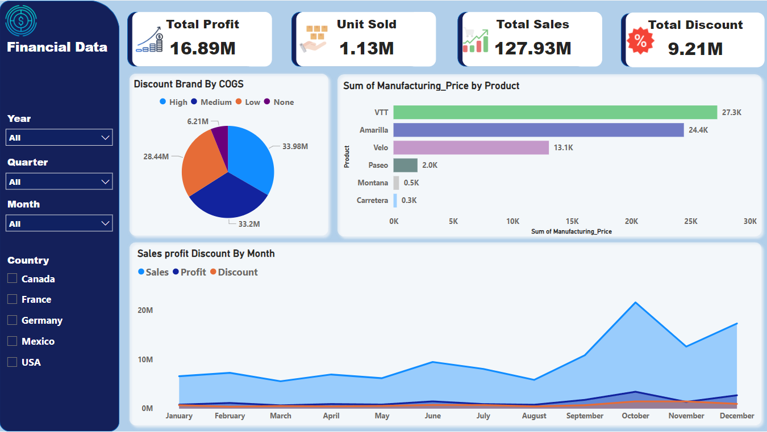
Dashboard Design Overview
The interactive dashboard design focuses on providing users with an intuitive interface to explore and analyze financial data effectively. The dashboard consists of four main cards, each containing key metrics and icons for navigation. Additionally, three slicers facilitate filtering by month, year, quarter, and country.
  Link for Power Bi Report
  Financial Report
  Note: The dashboard consists of four main cards, each containing icons for navigation.

Slide 24
Key Insights and Recommendations:
Sales Performance:
October emerged as the highest revenue-generating month with sales totaling $2,167,143.02, representing a significant increase of 287.90% compared to March, the lowest sales month at $558,859.87.
Product Analysis:
The product 'VTT' had the highest sum of manufacturing prices at $27,250, marking a substantial 9,667.03% increase over 'Carretera', the product with the lowest sum of manufacturing prices at $279.
'VTT' accounted for the largest portion, contributing 40.35% to the total sum of manufacturing prices across all products.
COGS Distribution:
'High' category products had the highest cost of goods sold (COGS) at $33,983,620, followed by 'Medium', 'Low', and 'None’.
'High' category products accounted for 33.37% of the total COGS.
Sales and Profit Relationship:
There exists a positive correlation between sales and total profit, indicating that increased sales lead to higher profits.
Focus Areas:
It's imperative to focus on enhancing sales performance, particularly in months with historically lower sales like March.
Products with lower manufacturing prices may require attention to improve their competitiveness and profitability in the market.
Understanding the factors contributing to high COGS in the 'High' category products can help optimize costs and improve profitability.

Slide 25
Opportunities for Growth:
October, being the highest revenue-generating month, presents an opportunity to capitalize on consumer spending trends and boost sales further.
Analyzing the product mix and identifying opportunities to introduce new products or adjust pricing strategies can help drive growth.
Month-over-month and product-wise analysis can provide actionable insights to optimize sales strategies and drive profitability.
Further Analysis:
Detailed analysis of sales and profit by segment, country, and discount bands can uncover additional opportunities for growth and optimization.
Exploring the impact of external factors like seasonality or market trends on sales performance can provide valuable insights for strategic decision-making

Slide 26
Driving Growth: Insights and Actions
Product Focus:
  Winning Products: Products like "Paseo" and "Velo" are doing really well. We should invest more in promoting them.
  Improvement Needed: Products like "Montana" and "Carretera" need some attention. We should think about how to make them more attractive to customers.
Customer Segments:
  Profitable Segments: The "Government" segment is bringing in the most profit. We should think about ways to expand our business with government clients.
  Room for Improvement: The "Enterprise" segment isn't doing so well. We need to figure out how to make our products more appealing to them.
Geographic Focus:
  Top Markets: The USA and Canada are our best markets. We should think about how to grow even more there.
  Opportunity Markets: Places like Mexico have potential for growth. We should explore how to increase sales in these areas.
Seasonal Trends:
  Busy Months: October and December are our busiest months. We should plan special promotions during these times to boost sales even more.
  Slow Months: Months like March and June have lower sales. We need to come up with ideas to attract more customers during these times.
Discount Strategies:
  Smart Discounts: We need to be smarter about when and how we offer discounts. By analyzing the data, we can figure out the best times and places to offer discounts to maximize their impact.

Slide 27
Financial Data
Gourav Kinker
Notes:
You can use this slide as your opening or closing slide. Should you choose to use it as a closing, make sure you review the main points of your presentation. One creative way to do that is by adding animations to the various graphics on a slide. This slide has 4 different graphics, and, when you view the slideshow, you will see that you can click to reveal the next graphic. Similarly, as you review the main topics in your presentation, you may want each point to show up when you are addressing that topic.
Add animation to images and graphics:
Select your image or graphic.
Click on the Animations tab.
Choose from the options. The animation for this slide is “Split”. The drop-down menu in the Animation section gives even more animations you can use.
If you have multiple graphics or images, you will see a number appear next to it that notes the order of the animations.
Note: You will want to choose the animations carefully. You do not want to make your audience dizzy from your presentation.

